Slide 1
Let’s read goodbooks!
General Assembly - Data Science Class #49
Athena Hu

Slide 2
Problem Statement
Which of the 25 features are the best predictors of average rating?
Using this dataset, how accurately can we predict average rating of a book?
Key Features
Title Length
Ratings Count
Series – Yes/No
Book Edition Count

Slide 3
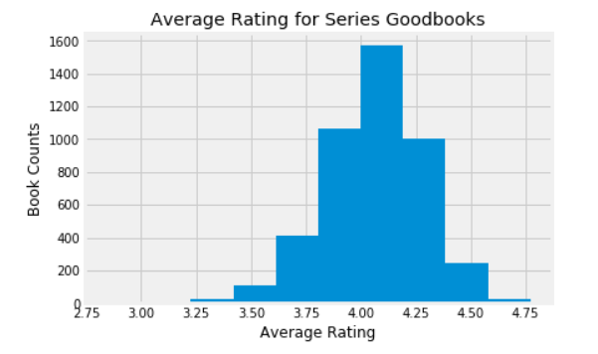
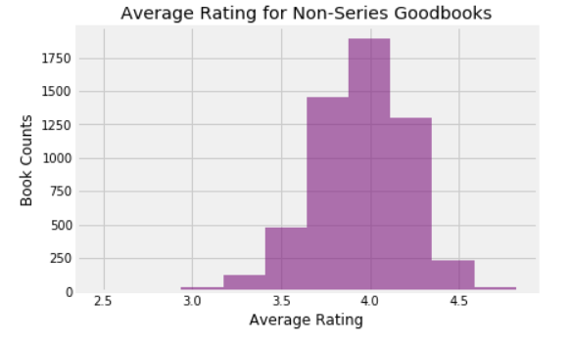
Get to know the data
Mean = 4.06
Source – Goodbooks
10K most popular books with 6 mil. ratings
Source is a site similar to goodreads.com
53,434 unique users
25 Total Features
23 from original dataset
2 added
Series_Y_N – Is the book part of a series
Title_Length – # of characters in a title
Mean = 3.95

Slide 4
Feature Selection
Created a subset of data that only looks at books within a series
Creates base assumption that predicting book is part of a series
Features
Title Length
Ratings Count
Predictor
Average Rating

Slide 5
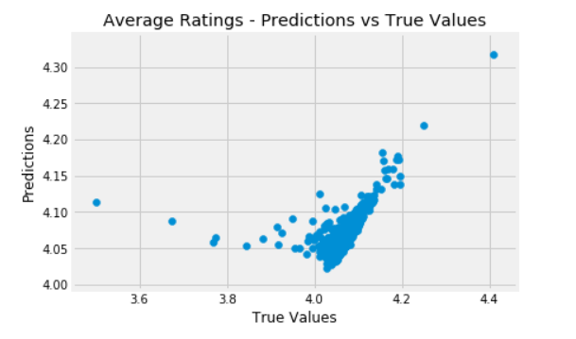
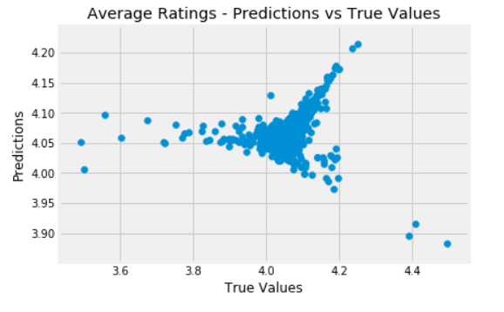
Model – Linear regression
TRAIN/TEST/SPLIT – LINEAR REGRESSION
5 K-FOLD
CROSS VALIDATION
ACCURACY SCORE: 0.31
ACCURACY SCORE: 0.12
The overall higher accuracy score in the single model indicates we have high bias in the model (our predicted values will vary greatly from the true values).
In other words, this is not a very good model.

Slide 6
Model Improvement
Data set with more uncorrelated features
A large number of the features in this data set are highly correlated – not good for feature selection
Additional features from other datasets via Joins/Merges
Incorporate features like genre, movie adaptions, target groups
Web-scraping techniques covered in the last class would be an interesting way to get a better data set
Classification Model
Perhaps using the data to classify whether a rating will be >4 or <4 would be more reliable

Slide 7
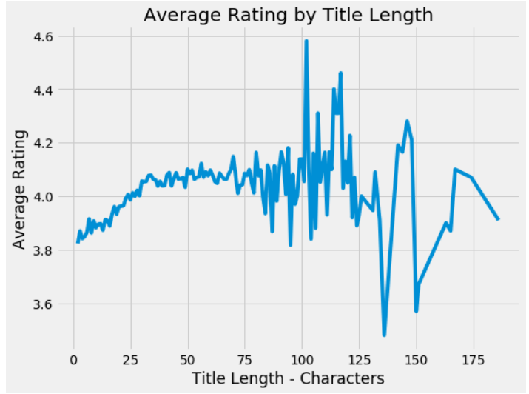
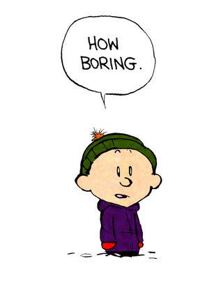
Fun Findings through Exploratory Analysis
4/10 of the highest rated books are Calvin and Hobbes related
The Hunger Games, Harry Potter and the Philosopher Stone, and Twilight are the most rated books in the dataset
Title length matters, to an extent:

